Slide 1
NextHikes IT Solutions
Feature Extraction and Price Prediction for Mobile Phones
By- Ankita Babar

Slide 2
Introduction :-
Smartphones come with different specifications such as RAM, memory, processor, battery, and camera. The price of a smartphone mainly depends on these features.
This project focuses on predicting mobile prices using machine learning algorithms based on their specifications.

Slide 3
Project Objective:-
Predict the price of mobile phones using machine learning • Analyze how different features affect mobile prices • Identify the most important features influencing price • Build an accurate prediction model

Slide 4
Data Understanding:-
Initial exploration of dataset included:
• Checking dataset structure • Identifying missing values • Understanding data types • Separating categorical and numerical features
This helped prepare the dataset for further processing.

Slide 5
Data Cleaning:-
During preprocessing some columns were removed.
Removed features:
• Unnamed column (index column) • Model column (not useful for prediction)
Removing unnecessary features helps improve model performance.

Slide 6
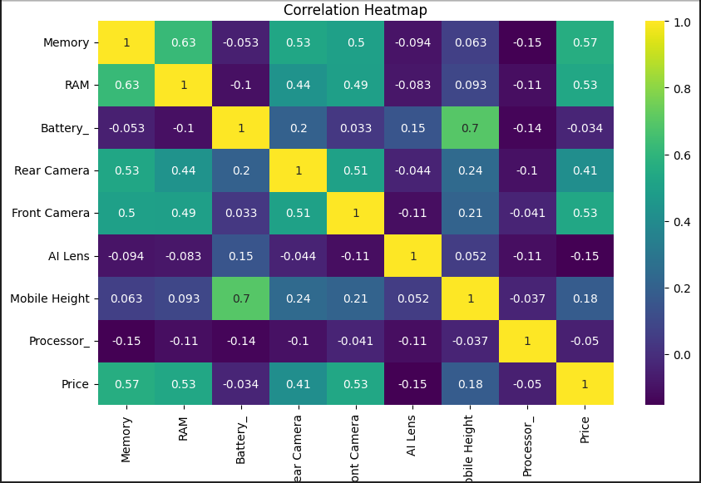
Heatmap shows relationships between features and price.
RAM has a strong positive correlation with price.
Memory also positively affects mobile price.
Rear camera has a moderate impact on price.
Battery has a slight positive relationship with price.
RAM and Memory are the most important factors for price.

Slide 7
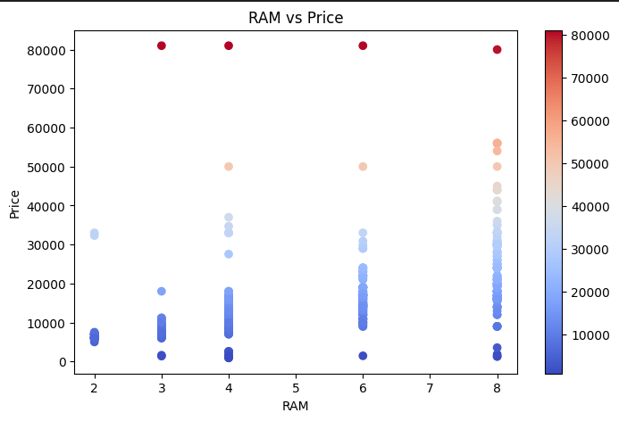
RAM vs PRICE
Strong positive relationship.
As RAM increases, price increases.
RAM is one of the most important pricing factors.
Higher RAM mobiles usually have higher prices.

Slide 8
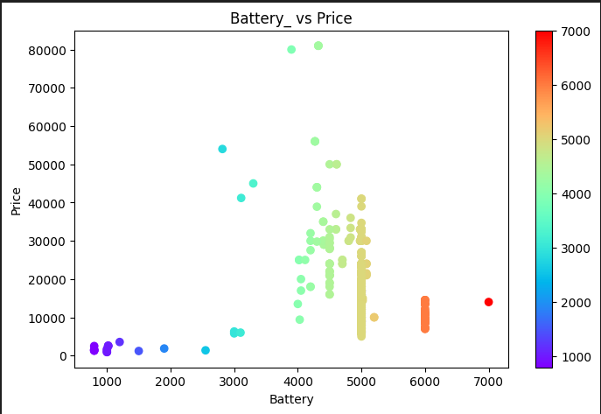
Battery vs Price
Insight: Slight positive trend.
Bigger battery slightly increases price.
But battery alone does not decide price

Slide 9
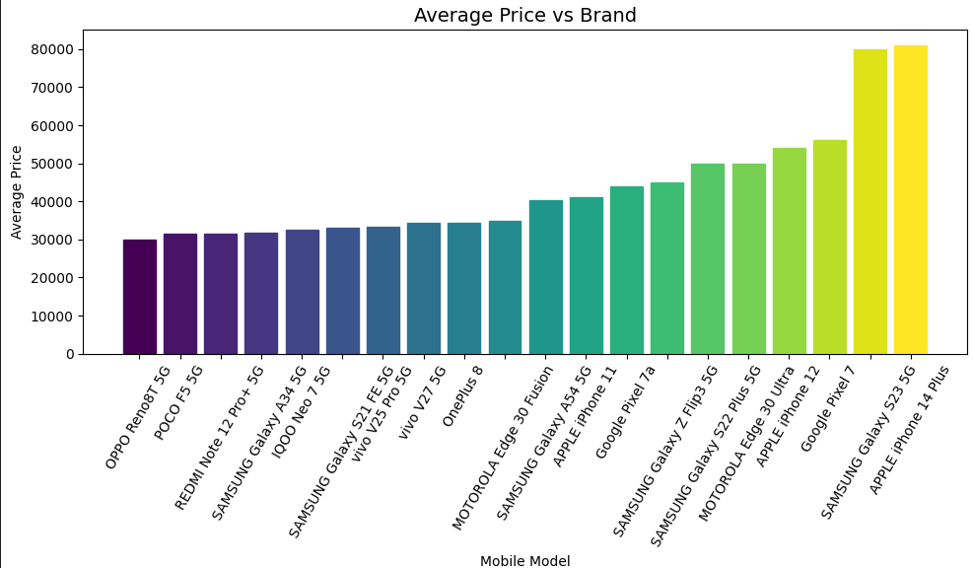
Average Price vs Brand
Premium brands have higher average prices.
Budget brands offer lower-priced mobiles.
The graph shows the average price distribution of different mobile models.
Some models fall in the premium price range, while others belong to budget segments.

Slide 10
Data Visualization Insights:-
Key insights observed:
• Higher RAM generally increases mobile price • Phones with larger memory tend to be more expensive • Processor type strongly affects price • Battery capacity has moderate impact on price

Slide 11
Feature Extraction:-
Important features were extracted and converted into useful formats.
Examples:
• Memory converted into numeric values (GB) • RAM converted into numeric format • Battery capacity used as numerical feature
This helps the model learn better patterns.

Slide 12
Label Encoding:-
Categorical features were converted into numeric values using Label Encoding.
Encoded features include:
• Colour • Processor • Camera related features
This step makes the data suitable for machine learning algorithms.

Slide 13
Model Acurracy:-
Performance of models:
Linear Regression – 80% accuracy Decision Tree – 85% accuracy Random Forest – 90% accuracy
Random Forest provided the best prediction results.

Slide 14
Challenges Faced & Solutions:-
Challenges:
• Handling categorical data • Cleaning inconsistent data • Feature selection
Solutions:
• Applied label encoding • Removed unnecessary columns • Used feature importance to select best features

Slide 15
Conclusion :-
Conclusion:
Random Forest model performed the best in predicting mobile prices.
Key factors affecting price:
• RAM • Memory • Processor • Camera

Slide 16
THANK YOU!!

